Slide 1
BioSentient Plastics Scanner: Fighting Greenwashing with AI
Team name: null
GitHub Link: github.com/haneefa96/BioSentient-Scanner

Slide 2
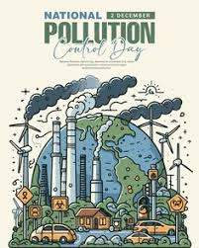
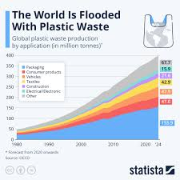
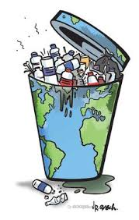
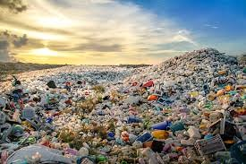
The Plastic Pollution Crisis
300M tons of plastic waste annually, 8M tons enter oceans (UNEP, 2023).
60% of "biodegradable" plastics don’t degrade due to greenwashing.
Misleads consumers, complicates recycling, harms environment.

Slide 3
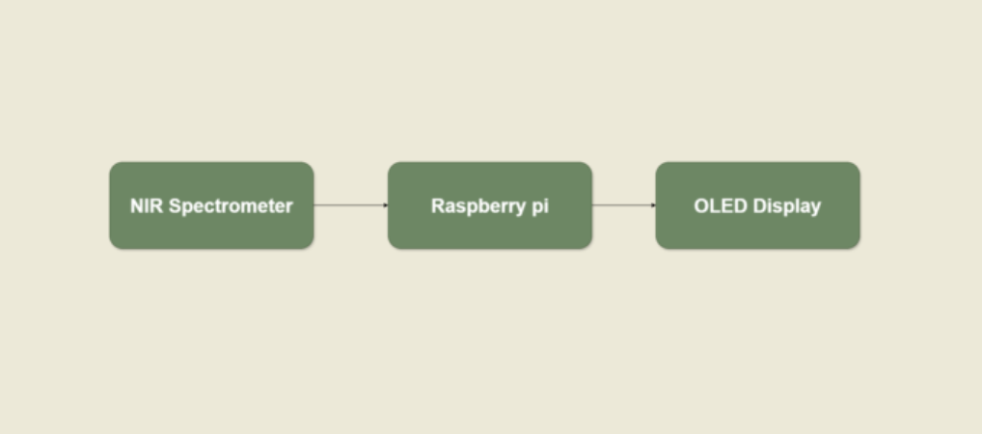
BioSentient Plastics Scanner (BPS)
Handheld or drone-mounted device using NIR spectroscopy and AI.
Assigns a BioScore (0-100) for biodegradability and suggests disposal.
Combats greenwashing by verifying eco-labels.

Slide 4
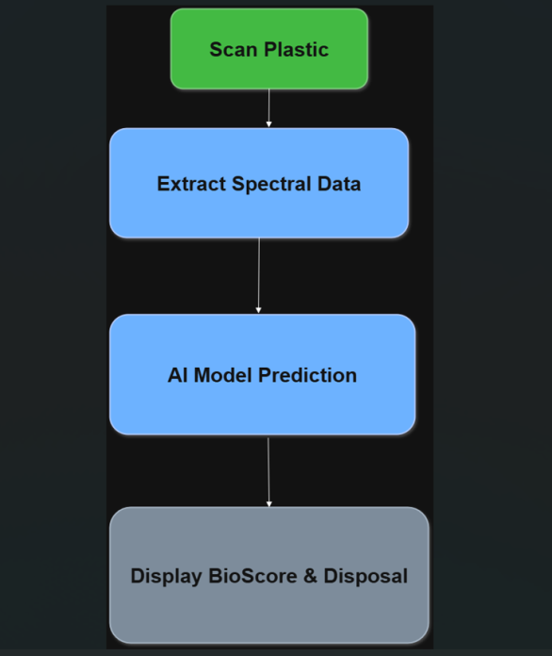
How BPS Works?
Hardware: NIR Spectrometer (SCiO), Raspberry Pi 4, OLED Display.
Software: Python, scikit-learn, Random Forest classifier.
Workflow: Scan -> Extract Spectral Data -> AI Prediction -> BioScore.

Slide 5
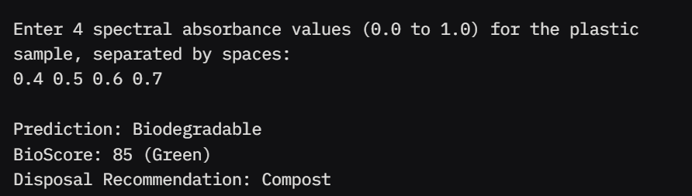
Demo: BioScore in Action
Interactive simulation classifies plastics using mock spectral data from data/spectral_data.csv.

Slide 6
BioScore: Simplifying Biodegradability
Formula: BioScore = (0.4 * Polymer Biodegradability) + (0.3 * Additive Impact) + (0.2 * Recyclability) + (0.1 * Disposal Compatibility).
Color Code: Green (80-100), Yellow (50-79), Red (0-49). Examples: PLA = 85 (Compost), PET = 30 (Recycle).
Use Cases: Consumer (shopper scans cup), Industrial (drone sorts plastics), Regulatory (verify eco-labels)..
Plastic | BioScore | Disposal
HDPE | 50 | Recycle
PLE | 85 | Compost
PET | 30 | Recycle

Slide 7
Impact and Scalability
Impact: Reduces greenwashing, improves recycling, supports regulations (e.g., EU Single-Use Plastics Directive).
Scalability: Consumer model ($100-$200), industrial drone ($5,000).
Partnerships: NGOs (e.g., Ocean Cleanup), governments.

Slide 8
Next Steps
Build physical prototype with Raspberry Pi and SCiO.
Collect real-world degradation data with university partners.
Develop mobile app and API for waste management integration..

